Slide 1
Modern Inventions
Presentation by Vivien Barkóczi & Balázs Bánszky

Slide 2
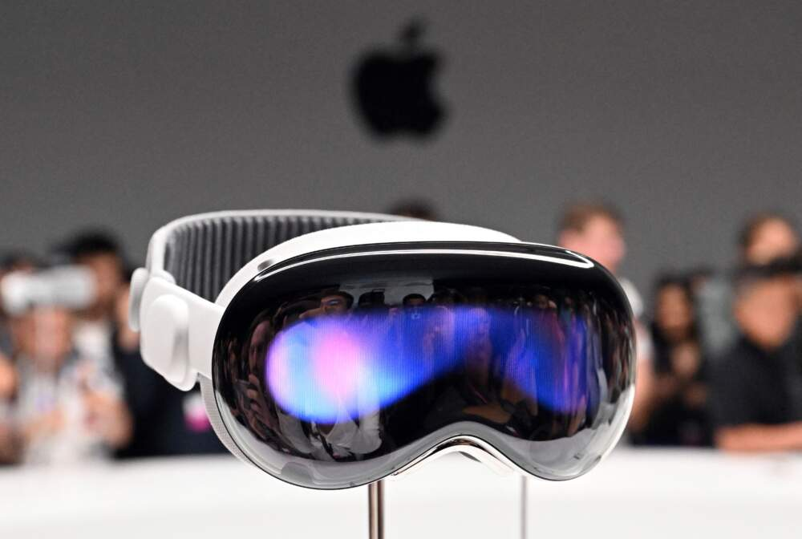
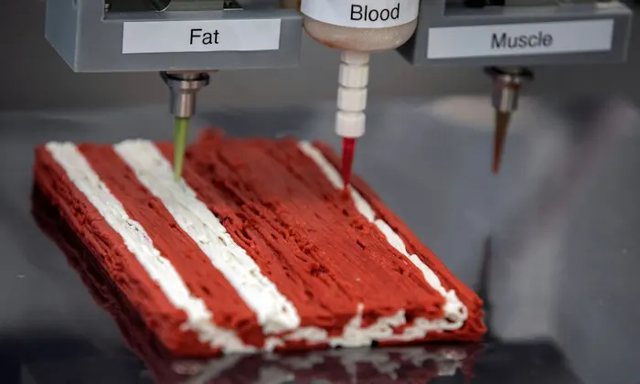
Latest Inventions
For us
For science
Virtual reality
Smart home
Smart phones
Neuralink
Reusable rockets
3D Food printing
Artificial intelligence

Slide 3
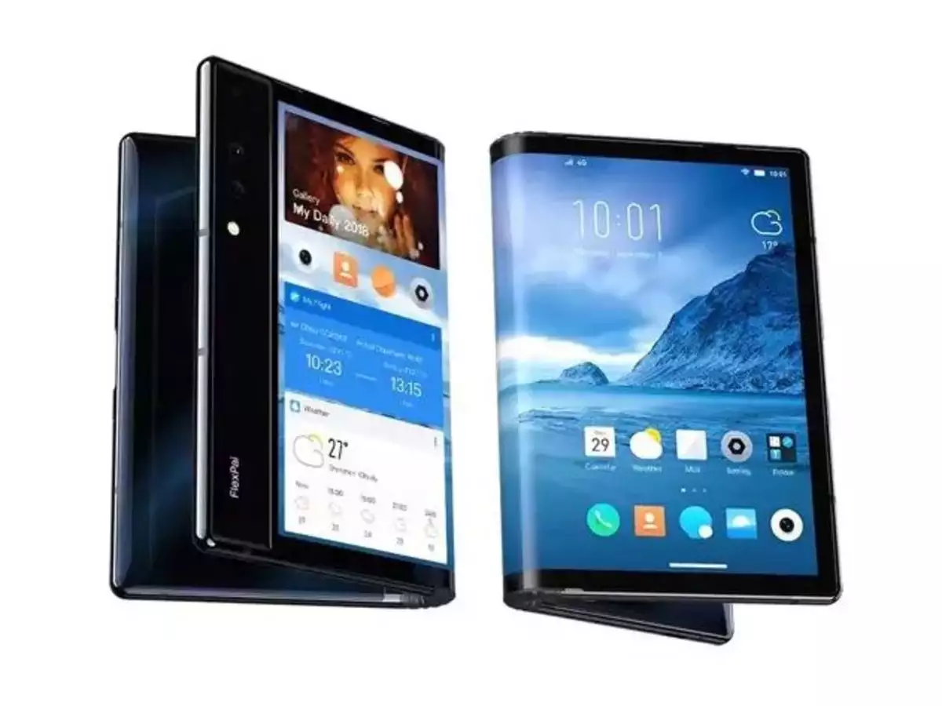
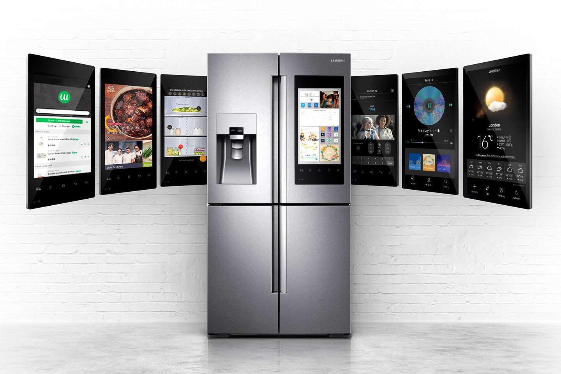
Everyday Life -
at Home
Foldable devices
Smart home
Robot vacuum cleaner
Home entertainment devices
Smart fridge

Slide 4
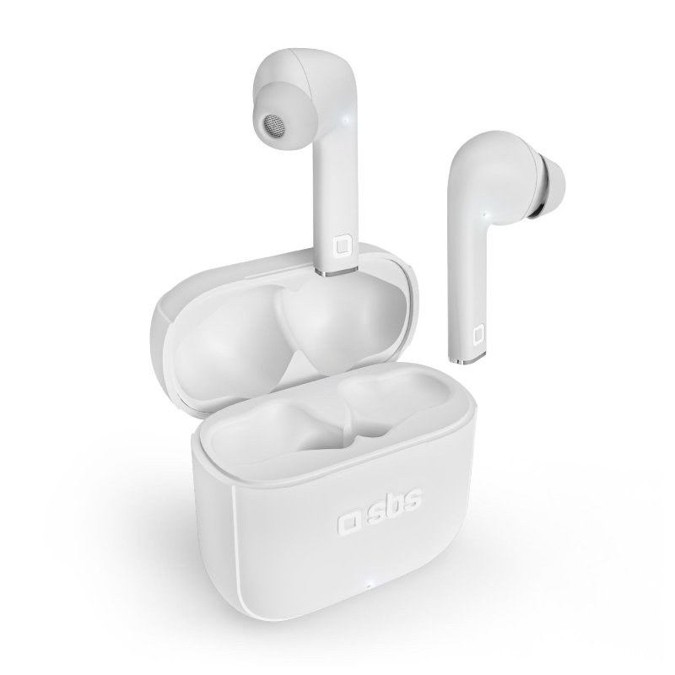
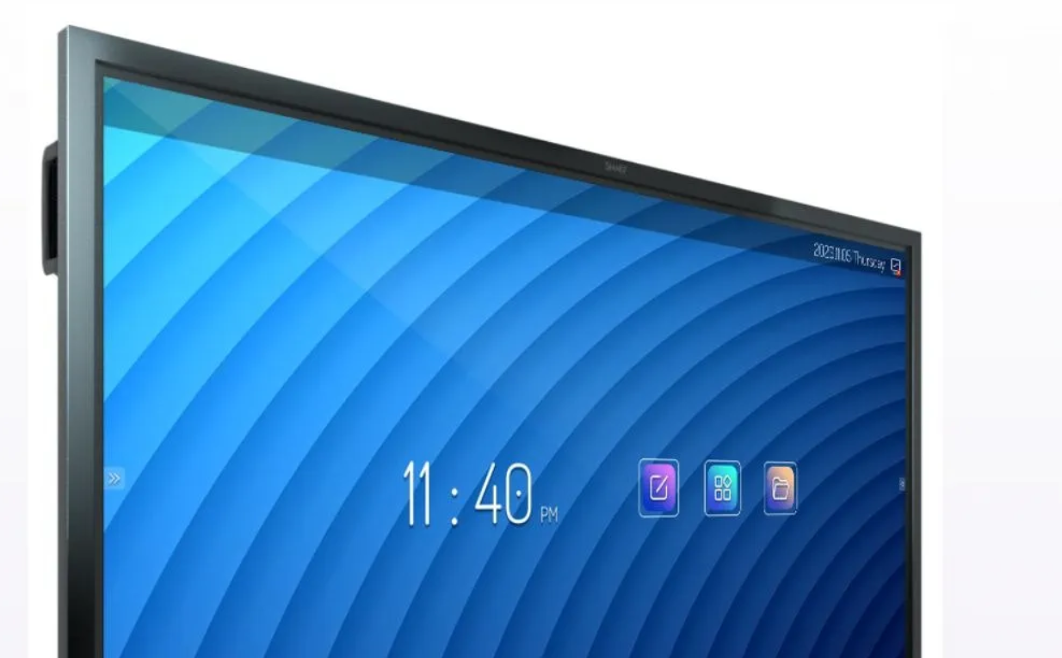
Everyday Life at School & Work
Wireless earbuds
Laptop
Printer
Projector
Electric board

Slide 5

What do we use it for
Generate source code with AI
Listen to music anywhere with wireless earbuds
To make our life easier & comfortable

Slide 6
Image Sources
https://www.wbur.org/hereandnow/2023/06/06/apple-vision-pro-vr-headset
https://www.theguardian.com/food/2021/nov/16/3d-printed-steak-taste-test-meat-mimic
https://timesofindia.indiatimes.com/most-searched-products/mobile-phones/mobiles/foldable-phones-samsung-huawei-motorola-and-other-brands-to-look-out-for/articleshow/72184624.cms
https://www.lifewire.com/smart-refrigerator-4158327
https://www.sbsmobile.com/fra/en/tws/8793-beat-free-true-wireless-stereo-earphones-with-touch-control-8018417427480.html
https://www.digitalclassworld.com/blog/digital-board-for-teaching/
https://github.com/pjbk/GitHubCopilot
https://www.forbes.com/sites/janakirammsv/2022/03/14/5-ai-tools-that-can-generate-code-to-help-programmers/?sh=437be7c65ee0

Slide 7
Thanks for your attention!

